Slide 1
ADVERSARIAL SEARCH
Abdus Salam Azad

Slide 2
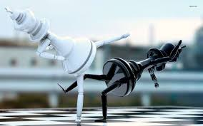
Objectives
Learning how to act when the other agents are
acting against us

Slide 3
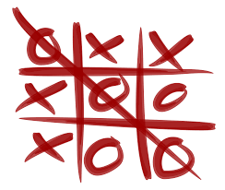
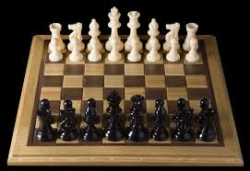
Games

Slide 4
Games vs. Search
Search – no adversary
Examples: path planning, scheduling activities
Games – adversary
Unpredictable opponent(s)
Solution is strategy (strategy specifies move for every possible opponent reply).
Time limits force an approximate solution
Inefficiency is intolerable

Slide 5
Zero Sum Game
Total pay off to all players is the same for every instance of games
Chess/Tic-tac-toe:
Win – 1
Lose – 0
Draw – ½

Slide 6
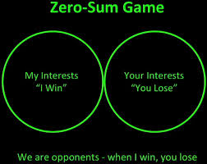
When I Win – You Lose

Slide 7
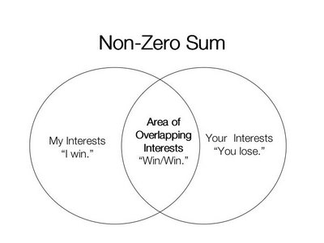

Slide 8
Assumptions
Two agents acting alternately
Utility values for each agent are the opposite of the other
Deterministic
Fully observable
Can generalize to stochastic games, multiple players, non zero-sum, etc
In game theory terms:
“Deterministic, turn-taking, zero-sum games of perfect information”

Slide 9
Games as search
Initial state: e.g. board configuration of chess
Player: which player to give the current move
Successor function: list of (move,state) pairs specifying legal moves.
Terminal test: Is the game finished?
Utility function: Gives numerical value of terminal states. E.g. win (+1), lose (-1) and draw (0) in tic-tac-toe or chess

Slide 10
Game Setup
Two players: MAX and MIN
MAX tries to maximize the utility
MAX moves first and they take turns until the game is over
MAX uses search tree to determine next move.
We plan as MAX

Slide 11
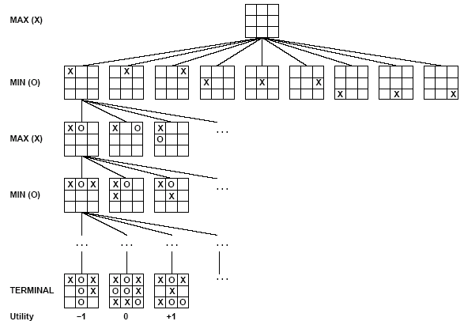
Partial Game Tree for Tic-Tac-Toe

Slide 12
Size of search trees
b = branching factor
d = number of moves by both players
Search tree is O(b^{d})
Chess
b ~ 35
D ~100
- search tree is ~ 10 ¹⁵⁴ (!!)
- completely impractical to search this
Game-playing emphasizes being able to make optimal decisions in a finite amount of time

Slide 13
Optimal Strategy
An optimal strategy leads to outcomes at least as good as any other strategy when the opponent plays optimally

Slide 14
Strategy 1
The minimax algorithm

Slide 15
The minimax algorithm
Find the optimal strategy for MAX assuming an optimal MIN opponent
Assumption: Both players play optimally!

Slide 16
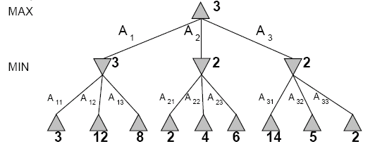
Two-Ply Game Tree

Slide 17
Two-Ply Game Tree

Slide 18
Two-Ply Game Tree

Slide 19
Two-Ply Game Tree
Minimax maximizes the utility for the worst-case outcome for max
The minimax decision

Slide 20
The minimax algorithm
Minimax value is the utility of MAX for being in the corresponding state
MINIMAX-VALUE(n)
UTILITY(n) If n is a terminal
max_{s ∈ successors(n)} MINIMAX-VALUE(s)
If n is a max node
min_{s ∈ successors(n)} MINIMAX-VALUE(s) If n is a min node

Slide 21
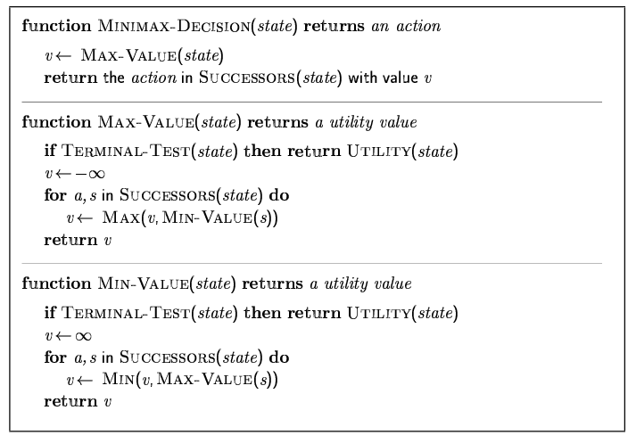
Minimax algorithm

Slide 22
Minimax is done depth-first
max
min
max
leaf
2 5 1

Slide 23
Properties of Minimax
Complete? Yes (if tree is finite)
Optimal? Yes (against an optimal opponent)
Time complexity? O(b^{m})
Space complexity? O(bm) (depth-first exploration)
For chess, b ≈ 35, m ≈100 for "reasonable" games → exact solution completely infeasible
Need to speed it up.

Slide 24
Strategy 2
Alpha Beta Pruning

Slide 25
Alpha-Beta Procedure
The alpha-beta procedure can speed up a depth-first minimax search.
Alpha: a lower bound on the value that a max node may ultimately be assigned
Beta: an upper bound on the value that a minimizing node may ultimately be assigned
v > α
v < β

Slide 26
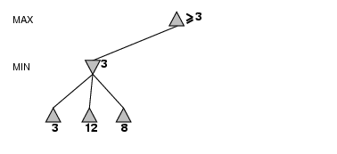
α-β pruning example

Slide 27
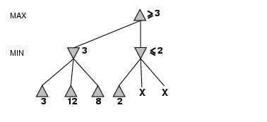
α-β pruning example
α = 3
alpha cutoff

Slide 28
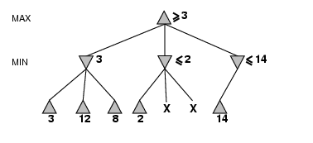
α-β pruning example

Slide 29
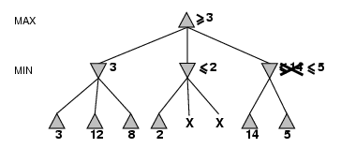
α-β pruning example

Slide 30
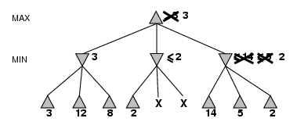
α-β pruning example

Slide 31
Properties of α-β
Pruning does not affect final result. This means that it gets the exact same result as does full minimax.
Good move ordering improves effectiveness of pruning
With "perfect ordering," time complexity = O(b^{m/2})
→ doubles depth of search

Slide 32
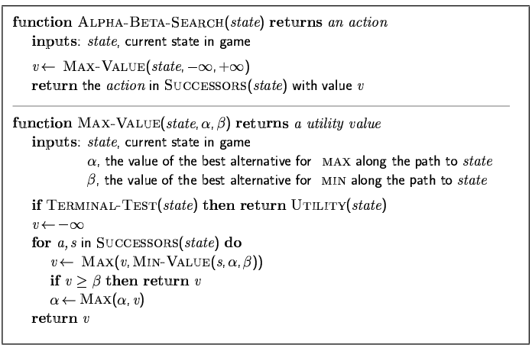
The α-β algorithm

Slide 33
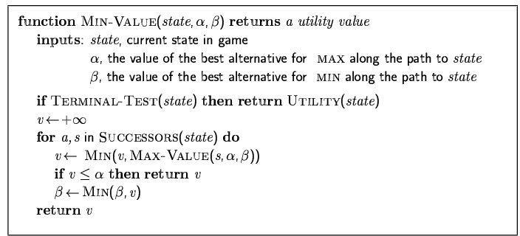
The α-β algorithm

Slide 34
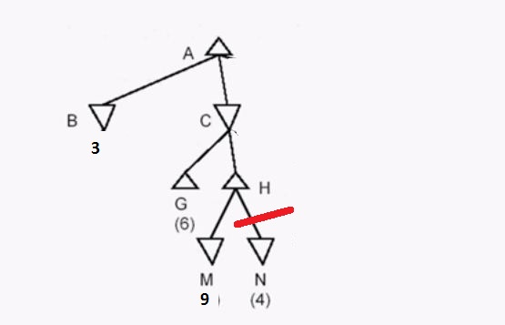
Example

Slide 35
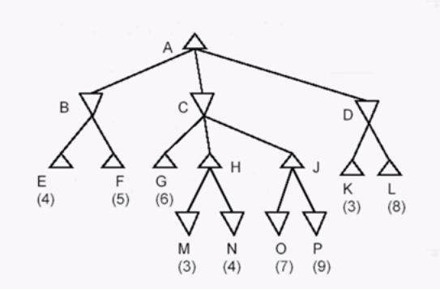
Example

Slide 36
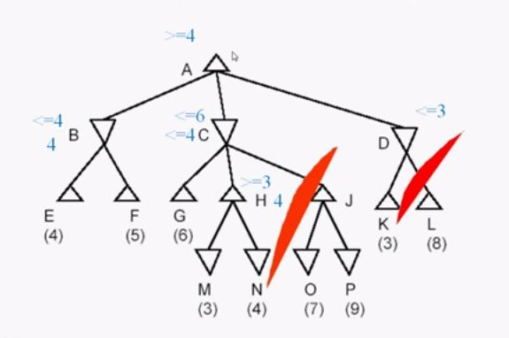
Example

Slide 37
Resource
Chapter 5
5.1, 5.2, 5.3

